Slide 1

UNIVERSITY INSTITUTE OF ENGINEERING
COMPUTER SCIENCE ENGINEERING
Bachelor of Engineering (Computer Science & Engineering)
Subject Name: STATISTICAL METHODS USING R
Subject Code: 20SMT-460
Discrete Distribution
Mapped with CO
Prepared By:
Ms. Hardeep Kaur
DISCOVER . LEARN . EMPOWER

Slide 2
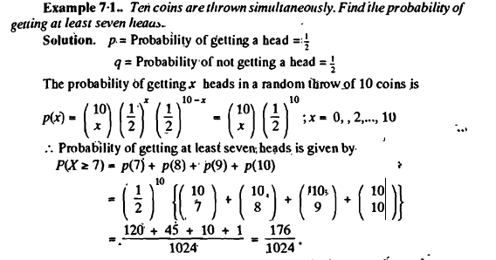
Examples

Slide 3
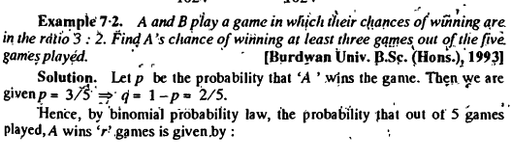
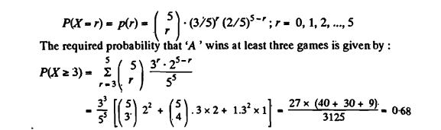

Slide 4
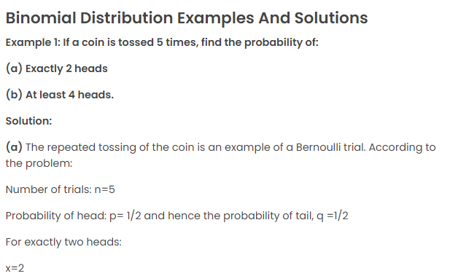

Slide 5
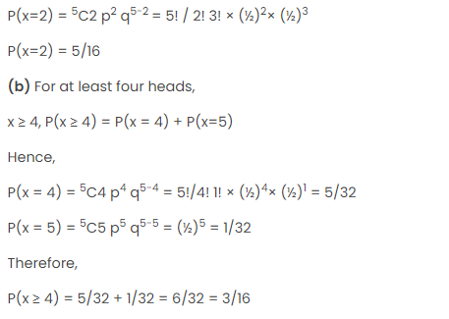

Slide 6
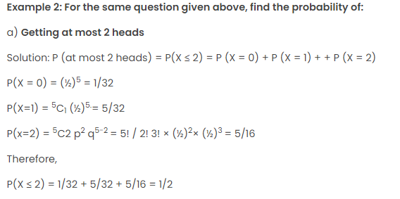

Slide 7
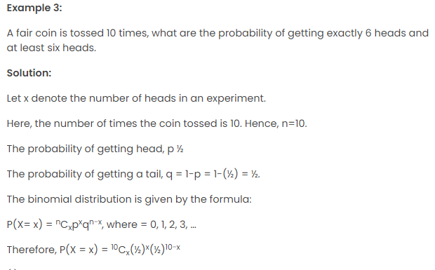

Slide 8
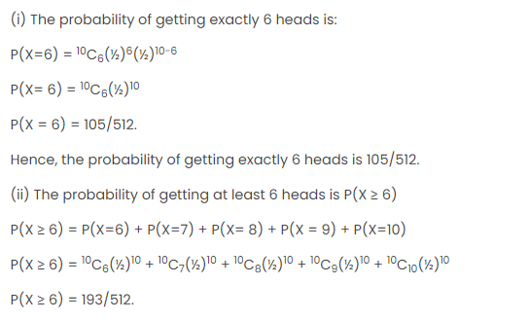

Slide 9
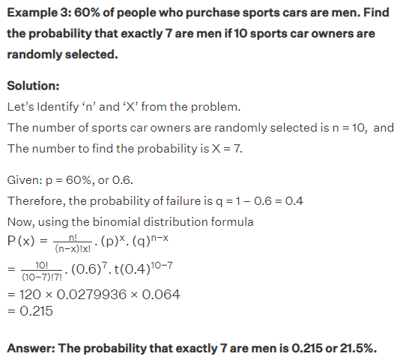

Slide 10
